Slide 1

CS4157
Software Quality
Notes:
CS5707 Software Development Paradigms
John Dawson
CS5707 Software Development Paradigms
John Dawson
CS5707 Software Development Paradigms
John Dawson

Slide 2
Lecture Outline: Week 6 – 27th February
Software Testing 2 of 2
Notes:
CS5707 Software Development Paradigms
John Dawson
CS5707 Software Development Paradigms
John Dawson
CS5707 Software Development Paradigms
John Dawson

Slide 3
Review
Introduction: Validation / Verification
Layers / Levels / Stages
Black Box / White Box
Hierarchy: Top-down / Bottom-up
Notes:
CS5707 Software Development Paradigms
John Dawson
CS5707 Software Development Paradigms
John Dawson
CS5707 Software Development Paradigms
John Dawson

Slide 4
Lecture Outline
Testing techniques
Buglist
Support for testing
Automated testing
Notes:
CS5707 Software Development Paradigms
John Dawson
CS5707 Software Development Paradigms
John Dawson
CS5707 Software Development Paradigms
John Dawson

Slide 5
Software Testing Techniques: 1a
Decision Tables
In simple cases can be exhaustive
Classic example is Myers triangle testing problem
  User enters three numbers, representing the length of the sides of a triangle
Program determines whether the triangle is: Equilateral, Isosceles, Scalene (neither) or is not a valid triangle

Slide 6
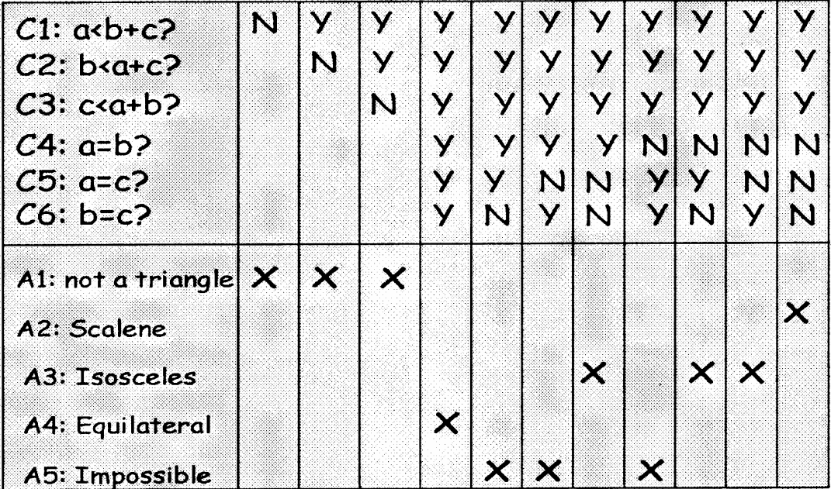
Software Testing Techniques: 1b

Slide 7
Software Testing Techniques: 2a
In practice, there are nearly always too many cases for exhaustive testing and we use the notion of equivalence classes, more or less formally; a simple example:
The user enters a number between 1 and 12
We might take the three cases: <1, >12 and between 1 & 12 only i.e. we consider entering (say) 20 is equivalent to entering every (possible) number greater than 12
By this means, the number of necessary tests can be significantly reduced i.e. the non testable becomes testable

Slide 8
Software Testing Techniques: 2b
We might also consider the related topic of Boundary Value Testing
If this case, we would include entering 0, 1 & 2; also 11,12 & 13
Extending the idea slightly, we might check 5 & 6, also negative numbers and very large numbers

Slide 9
Software Testing Techniques: 2c
Boundary Value Testing concepts
Extreme values
Worst case testing
Error conditions
Deliberate provocation of errors / exceptions (⇒ white box)

Slide 10
Lecture Outline
Testing techniques
Buglist
Support for testing
Automated testing
Notes:
CS5707 Software Development Paradigms
John Dawson
CS5707 Software Development Paradigms
John Dawson
CS5707 Software Development Paradigms
John Dawson

Slide 11
Buglist 1
A buglist is a basic requisite of a good quality testing process; some attributes:
Confers visibility
  To developers, managers, customers
Quantification: should be complete i.e. nothing of concern not on the list
Analysis(s)
  How many bugs at priority X
  How many bugs in module Y
  How many bugs assigned to developer Z

Slide 12
Buglist 2
It is common practice to have more than one instance or type of buglist
Typically, a programmer might maintain a private buglist, before releasing software for the next stage of – public – testing
Similarly, a company with a customer base may maintain a buglist for each customer, shared with that customer, but also an internal buglist, for the use of the development team i.e. not visible to customers

Slide 13
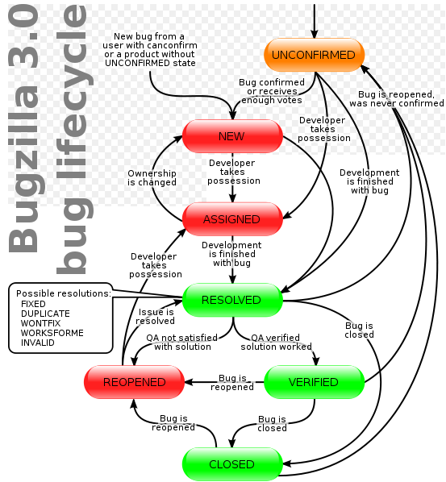
Bug Report Life-cycle
(from Bugzilla)

Slide 14
Buglist 4
What is recorded on a buglist?

Slide 15
Buglist 4
Reference / ID
Date-time
Reported by
Category
Sub-category
Severity
Description
Hardware info.
Attachment(s)
Status of bug
Assigned to
Comment
Follow-up(s)

Slide 16
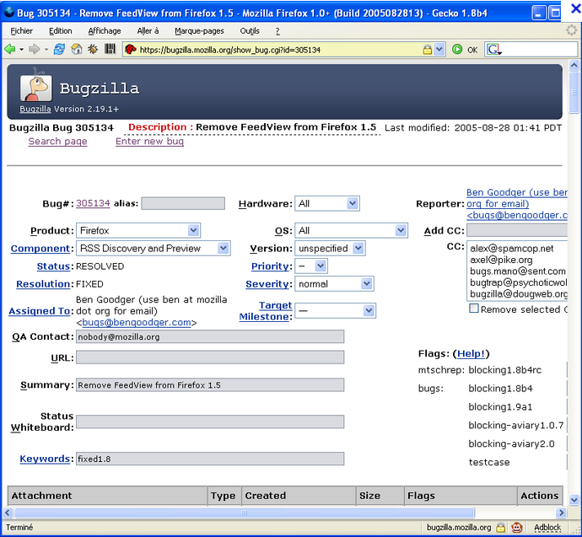
Bug-zilla: 1

Slide 17
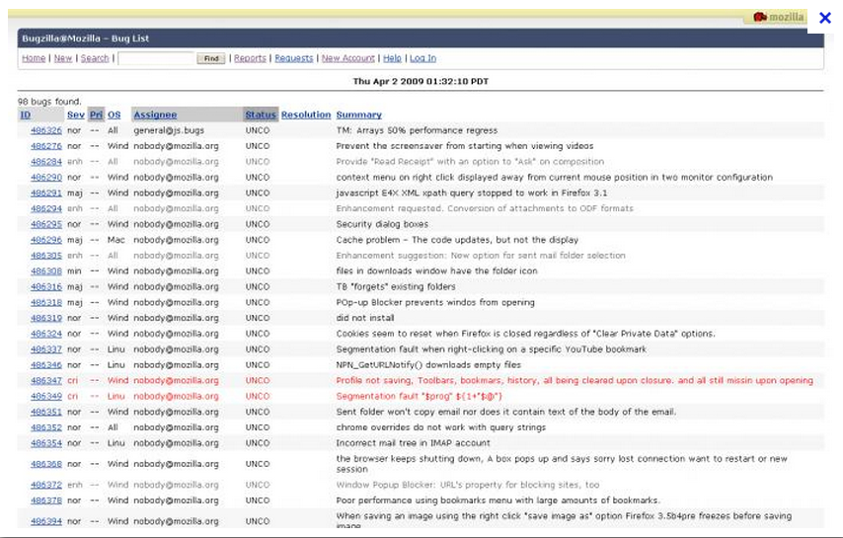
Bugzilla: 2

Slide 18
Buglist 5
For small projects / companies a spread-sheet is sufficient, even preferable:
Pros
Free, quick, simple, flexible
Sub-totals can provide simple metrics
Sorting, filtering & charts ⇨ quick reports
Cons
Write access is single user ⇨ only suitable for small co-located teams
Not so easy to control input

Slide 19
Lecture Outline
Testing techniques
Buglist
Support for testing
Automated testing
Notes:
CS5707 Software Development Paradigms
John Dawson
CS5707 Software Development Paradigms
John Dawson
CS5707 Software Development Paradigms
John Dawson

Slide 20
Support for Testing: 1
All types: Test specifications
Transaction processing systems
Good quality test data: static & dynamic
Control systems
Input and output simulation & logging
Transformation systems
Test data sets
Notes:
CS5707 Software Development Paradigms
John Dawson
CS5707 Software Development Paradigms
John Dawson
CS5707 Software Development Paradigms
John Dawson

Slide 21
Support for Testing: 2
IDE: Develop / Unit Test – integrated
Debugging tools (white box)
Appropriate test environment – to avoid conflict between testers
Notes:
CS5707 Software Development Paradigms
John Dawson
CS5707 Software Development Paradigms
John Dawson
CS5707 Software Development Paradigms
John Dawson

Slide 22
Lecture Outline
Testing techniques
Buglist
Support for testing
Automated testing
Notes:
CS5707 Software Development Paradigms
John Dawson
CS5707 Software Development Paradigms
John Dawson
CS5707 Software Development Paradigms
John Dawson

Slide 23
Automated testing
Highly desirable, especially for regression testing – and time-saving; issues
Highly problematic for variable inputs e.g. UI with mutliple permutations
Complexity Barrier: the (automated) test tends to become as complex as the software under test, hence as bug-prone ...
Pesticide Paradox: efforts to find more bugs leaves a residue of subtler bugs ...
Generally most useful at lowest level
Notes:
CS5707 Software Development Paradigms
John Dawson
CS5707 Software Development Paradigms
John Dawson
CS5707 Software Development Paradigms
John Dawson

Slide 24
Software Testing: Myers' Axioms
A good test case is one that has a high probability of detecting a previously undiscovered defect, not one that shows that the program works correctly
One of the most difficult problems in testing is knowing when to stop
It is impossible to test your own program
A necessary part of every test case is a description of the expected output
Avoid non-reproducible or on-the-fly testing
Write test cases for invalid as well as valid input conditions
Thoroughly inspect the results of each test
As the number of detected defects in a piece of software increases, the probability of the existence of more undetected defects also increases
Assign your best programmers to testing
Ensure that testability is a key objective in your software design
The design of a system should be such that each module is integrated into the system only once
Never alter the program to make testing easier (unless it is a permanent change)
Testing, like almost every other activity, must start with objectives

Slide 25
Next Week
Configuration Management
Notes:
CS5707 Software Development Paradigms
John Dawson
CS5707 Software Development Paradigms
John Dawson
CS5707 Software Development Paradigms
John Dawson

Slide 26
Reading
Reading
Sommerville, Ian (2006) Software Engineering (update) (8th edition), Addison-Wesley, chapter 23
Notes:
CS5707 Software Development Paradigms
John Dawson
CS5707 Software Development Paradigms
John Dawson
CS5707 Software Development Paradigms
John Dawson

